Slide 1
Summary of the experiments - 2
Mar – 11 -2020

Slide 2
Contents
Ten fold cross-validation results
Experimental results on the test set
Remarks

Slide 3
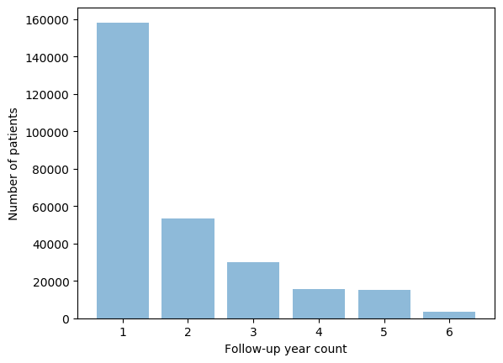
Dataset
This study considers only patients with
at least 2 years of continuous annual medical check-up during the follow-up period
not previously diagnosed with Diabetes
No missing features Instances
 | Training set | Testing set
Diabetes | 20,315 | 200
Prediabetes | 20,315 | 200
Normal | 20,315 | 200
Region of interest

Slide 4
1. Cross-validation results
10 Fold Cross-validated scores on 12 features set and 5 features set [traditional features set] are presented
In the experiment, we concatenated n (n=1,2,3,4) years of data to test the performance of the prediction models
12 features set
5 features set

Slide 5
2. Test Set results
This section presents the experimental results only on the test
The detail result of each model is presented in the subsequent pages
12 features set
5 features set

Slide 6
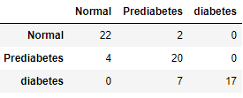
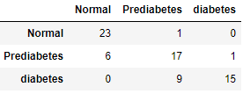
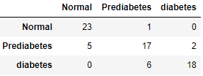
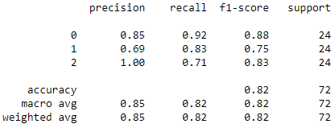
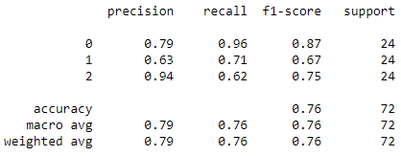
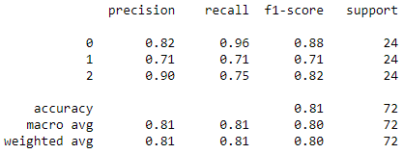
2. Test Set results
4 years training data with 12 feature set
Dataset distribution: [diabetes=119, prediabetes=1,762, Normal =2,628]
Training set size: 1,712 data points per class
Testing set size:24 data points per class
RF
Accuracy = 0.819
Accuracy: 0.82 (+/- 0.01)
XGBoost
Accuracy = 0.763
Accuracy: 0.80 (+/- 0.02)
SVM
Accuracy = 0.805
Accuracy: 0.78 (+/- 0.01)

Slide 7
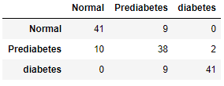
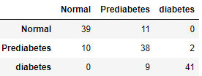
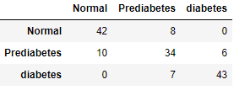
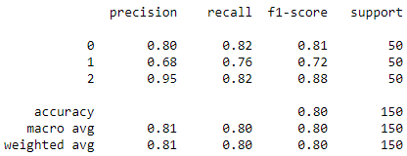
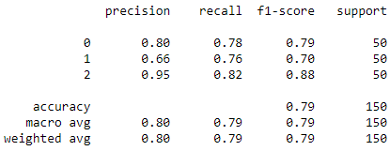
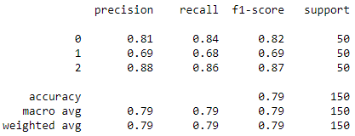
2. Test Set results
3 years training data with 12 feature set
Dataset distribution: [diabetes=266, prediabetes=4,034, Normal = 7,060]
Training set size: 3,984 data points per class
Testing set size: 50 data points per class
RF
Accuracy = 0.8
Accuracy: 0.81 (+/- 0.01)
XGBoost
Accuracy = 0.786
Accuracy: 0.80 (+/- 0.01)
SVM
Accuracy = 0.793
Accuracy: 0.77 (+/- 0.01)

Slide 8
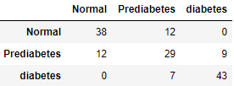
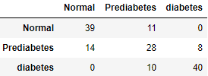
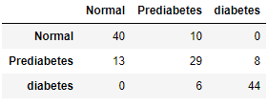
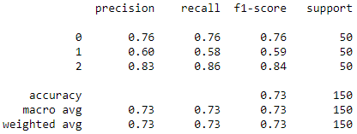
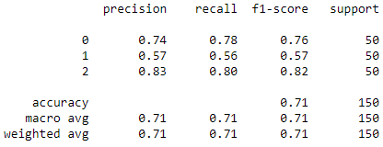
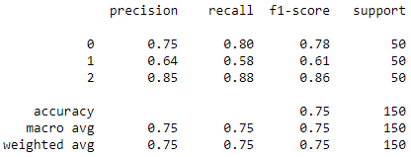
2. Test Set results
2 years training data with 12 feature set
Dataset distribution: [diabetes=597, prediabetes=9,103, Normal = 17,951]
Training set size: 9,053 data points per class
Testing set size: 50 data points per class
RF
Accuracy = 0.733
Accuracy: 0.79 (+/- 0.01)
XGBoost
Accuracy = 0.713
Accuracy: 0.78 (+/- 0.01)
SVM
Accuracy = 0.753
Accuracy: 0.76 (+/- 0.01)

Slide 9
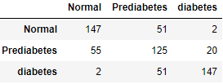
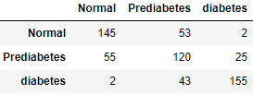
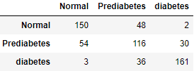
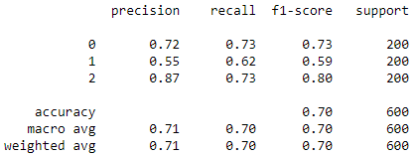
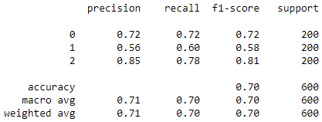
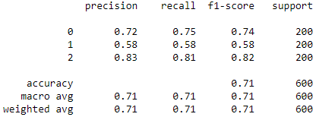
2. Test Set results
1 year training data with 12 feature set
Dataset distribution: [diabetes= 1,370, prediabetes= 20,515, Normal = 41,094]
Training set size: 20,465 data points per class
Testing set size: 200 data points per class
RF
Accuracy = 0.698
Accuracy: 0.75 (+/- 0.04)
XGBoost
Accuracy = 0.7
Accuracy: 0.72 (+/- 0.04)
SVM
Accuracy = 0.711
Accuracy: 0.73 (+/- 0.03)

Slide 10
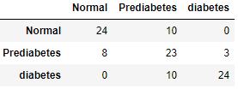
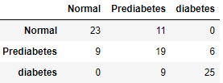
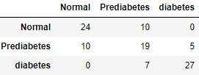
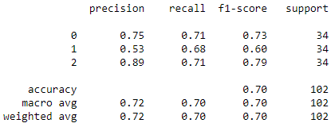
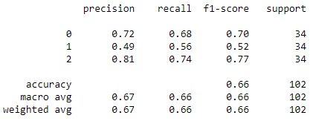
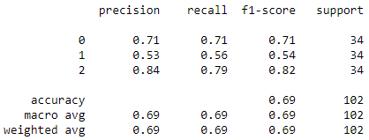
2. Test Set results
4 years training data with 5 feature set
Dataset distribution: [diabetes= 169, prediabetes= 2,349, Normal = 3,212]
Training set size: 2,315 data points per class
Testing set size: 34 data points per class
RF
Accuracy = 0.696
Accuracy: 0.78 (+/- 0.05)
XGBoost
Accuracy = 0.656
Accuracy: 0.74 (+/- 0.05)
SVM
Accuracy = 0.686
Accuracy: 0.75 (+/- 0.03)

Slide 11
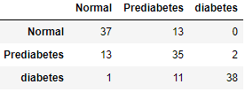
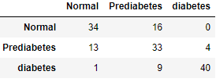
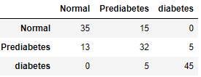
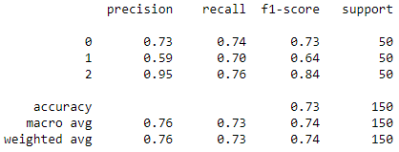
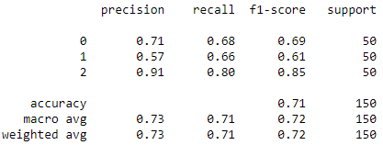
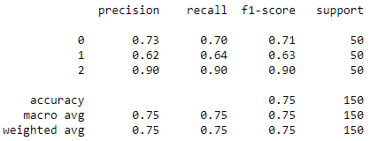
2. Test Set results
3 years training data with 5 feature set
Dataset distribution: [diabetes= 212, prediabetes=3,758, Normal = 6,888]
Training set size: 3,708 data points per class
Testing set size: 50 data points per class
RF
Accuracy = 0.733
Accuracy: 0.77 (+/- 0.05)
XGBoost
Accuracy = 0.713
Accuracy: 0.73 (+/- 0.05)
SVC
Accuracy = 0.746
Accuracy: 0.75 (+/- 0.03)

Slide 12
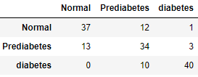
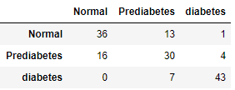

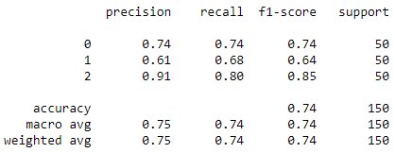
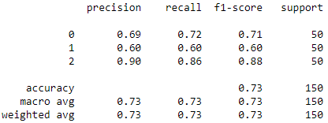
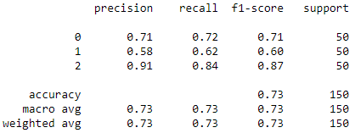
2. Test Set results
2 years training data with 5 feature set
Dataset distribution: [diabetes= 726, prediabetes= 10,492, Normal = 19,694]
Training set size: 10,292 data points per class
Testing set size: 200 data points per class
RF
Accuracy = 0.74
Accuracy: 0.77 (+/- 0.05)
XGBoost
Accuracy = 0.726
Accuracy: 0.72 (+/- 0.05)
SVM
Accuracy = 0.726
Accuracy: 0.74 (+/- 0.03)

Slide 13

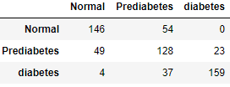
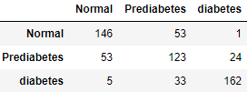
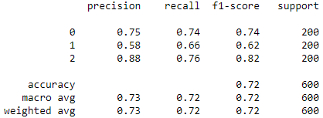
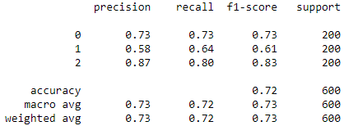
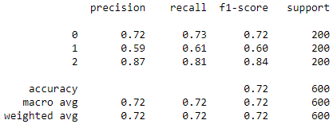
2. Test Set results
1 year training data with 5 feature set
Dataset distribution: [diabetes= 1,156, prediabetes= 18,708, Normal = 40,171]
Training set size: 18,508 data points per class
Testing set size: 200 data points per class
RF
Accuracy = 0.72
Accuracy: 0.74 (+/- 0.04)
XGBoost
Accuracy = 0.721
Accuracy: 0.70 (+/- 0.04)
SVM
Accuracy = 0.718
Accuracy: 0.71 (+/- 0.03)

Slide 14
3. Remarks
As the number of years used to train the models increases the performance of the models tend to increase in both feature set based on the cross-validation results. However, if we look in detail for the 5 features set models, the performance shows a slight decline as the feature increase. Since cross-validation trains and tests on different datasets, it can be considered as a baseline performance measure as compared to the results on a single test set.
The performance of the models with 12 features set outperforms the traditional feature sets. Despite the difference in the number of features, we can generalize that the selected 12 features are good enough to be used as diabetes indicator variables and we can emphasize this result on the manuscript as a contribution.

